Slide 1
Updating Tables

Slide 2

Objectives
How Update works
Constraints
Continuous Data Protection
Time Travel
Fail Safe
Sampling Data
Benefits
Deletion Considerations
Table Interpolation
Snowflake Automation
Best Practice

Slide 3
How Updates Work
Update is a combination of delete and insert operations
Blob storage area similar to s3
If more than 80% of records get updated then delete the entire table
We need to update the data
Finds micro partition
Delete row 2
Completely new row is added
Notes:
Blob storage – show micro partitions how the entire micro partition has to be deleted to update it then a new one is inserted
Even though only a part of the micro partition needs to be deleted blob storage does not work that way.
The entire row 2 will be deleted
When updating or deleting try considering numeric columns as it’s easy to order the data when it is first loaded and then even easier to scan the micro partitions

Slide 4
Constraints and Null Handling
What are constraints?
NOT NULL - Ensures that a column cannot have a NULL value
UNIQUE - Ensures that all values in a column are different
PRIMARY KEY - A combination of NOT NULL and UNIQUE
FOREIGN KEY - Uniquely identifies a row/record in another table
CHECK - Ensures that all values in a column satisfies a specific condition
DEFAULT - Sets a default value for a column when no value is specified
INDEX - Used to create and retrieve data from the database very quickly
Constraints that Snowflake enforces
NOT NULL - Ensures that a column cannot have a NULL value
Why? – Migration of data from other DB tools – just for reference and building models

Slide 5

Continuous Data Protection
Current Data Storage
Time Travel Retention (1-90Days)
Fail-Safe (transient:0days) Permant:7days
Continuous Data Protection Life Cycle
Time Travel:
SELECT … AT| BEFORE
CLONE… AT|BEFORE
UNDROP
Standard operations:
Queries, DDL, DML
Only Snowflake:
Data only recoverable by Snowflake
Notes:
Fail safe is a non-configurable for 7 days by only Snowflake
Mediate risk by creating backup tables
Can increase cost exponentially – so be careful

Slide 6
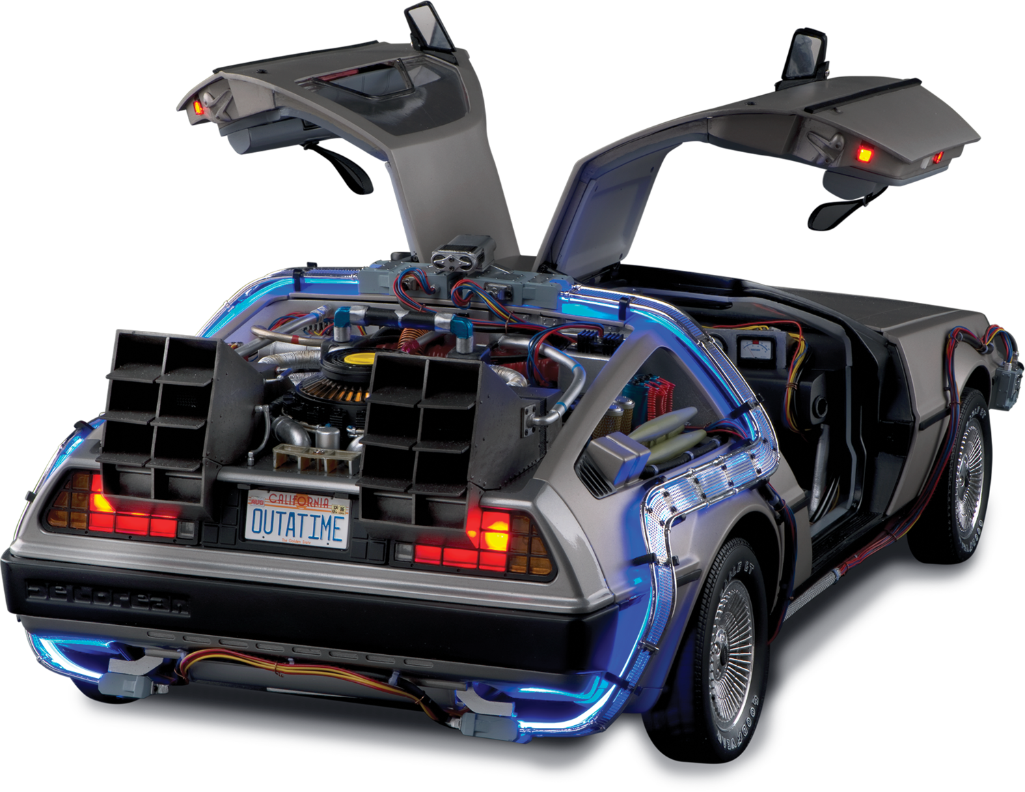

Back to the Future
Allows to return to older version of table
How long can you Time Travel back?
The table no longer exists if a new table is created
Create backups for large time travel changes to check work before overwriting
SELECT * FROM transactions
UPDATE transactions set first_name = “frank”
UPDATE transactions set city = “Los Angeles”
CREATE OR REPLACE TABLE transactions
AS
SELECT * FROM transactions AT (OFFSET => -60*10)
Notes:
What is the table retention period? Usually the default is 1 day

Slide 7
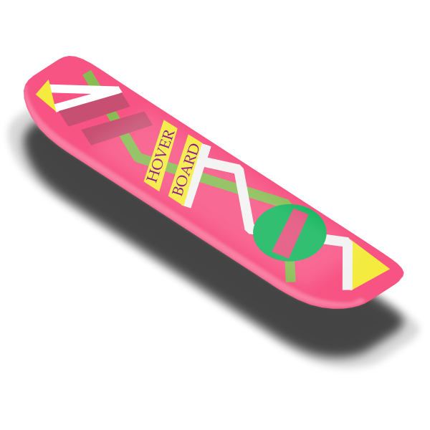
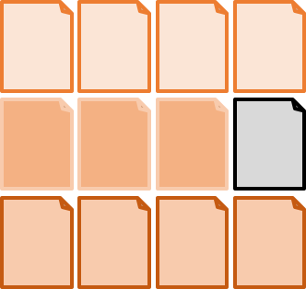
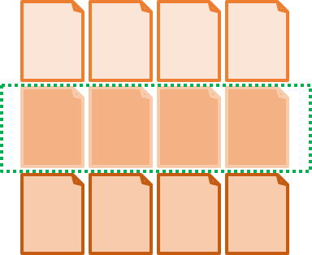
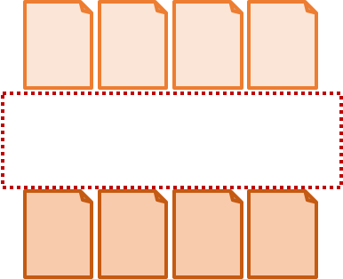
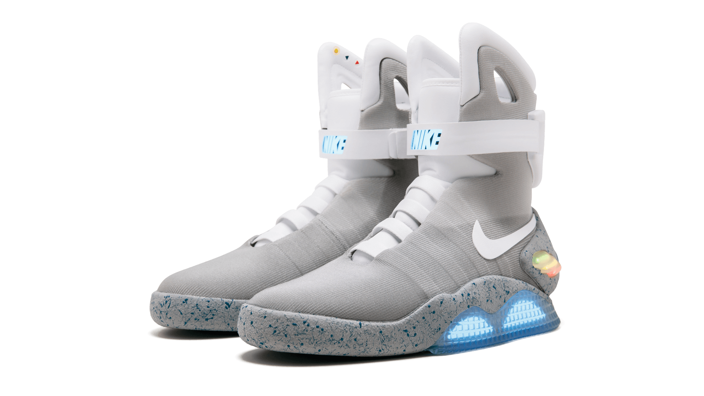
Back to the Future II
Time 1
Time 2
Time 3
Time 1
Time 2
Time 3
Table metadata
Table metadata
Notes:
Metadata reference is removed even though data persists so Time travel is possible
If we want to go back to time 2 the metadata reference is returned
Snowflake manages metadata storage
24 hr retention period is the default
Ask a question about change at 2pm Monday – can I make a change at 1pm Tuesday?

Slide 8
Fail Safe
Fail safe is a non-configurable for 7 days
Mediate risk by creating backup tables
Only accessible by Snowflake
Can increase cost exponentially – so be careful
Notes:
Why Fail-safe Instead of Backup?
Data corruption or loss can happen with any database management system. To mitigate the risk, DBAs traditionally perform full and incremental backups, but this can double or even triple overall data storage. In addition, data recovery can be painful and costly due to numerous factors, including:
Time required to reload lost data.
Business downtime during recovery.
Loss of data since the last backup.
Snowflake’s multi-data center, redundant architecture greatly reduces the need for traditional backup; however, risks still exist because data corruption/loss can occur inadvertently. Fail-safe provides an efficient and cost-effective alternative to backup that eliminates the remaining risk and scales with your data.

Slide 9
Fail Safe
All permanent tables that are created/updated/deleted also creates a Fail Safe Copy
Table Created | Name | Change time | Retention period | Time into fail safe | size
1/1/2020 | transactions | 1pm | 24hrs | 1/2/2020 1pm | 1TB
1/1/2020 | transactions | 7pm | 24hrs | 1/2/2020 7pm | 1TB
1/2/2020 | transactions | N/A | 24hrs | N/A | 0TB
1/3/2020 | transactions | N/A | 24hrs | N/A | 0TB
1/4/2020 | transactions | 2pm | 24hrs | 1/5/2020 2pm | 1TB
1/5/2020 | transactions | 5pm | 24hrs | 1/6/2020 5pm | 1TB
_
_| 2TB
_
_| 2TB
Notes:
Your table has stayed at 1TB however the Fail Safe zone has ballooned up to 4 TB
Permanent tables have a retention period and fail safe
Transient have retention period but no fail safe
Temporary tables have neither retention or fail safe
Can also update data retention time – but if permanent will go immediately into failsafe
If you don’t add the transient table clause you are creating a permanent table

Slide 10


Sampling Data
Snowflake can handle huge amounts of data but doesn’t mean we should run all queries on entire data set
Trends are sufficient for analysts rather than all the details
Two sampling methods
Bernoulli – Row
Snowflake selects each row of the Form table with <p>/100 probability
System – Block
Sample is formed of randomly selected blocks of data rows forming the micro partitions
Which is better?
Depends on the Data
Notes:
Approximate Query processing – is data querying method to provide approximate answers to queries at a fraction of the usual cost. Both in terms of time and processing resources: big data and fast but not entirely accurate.
It is similar to viewing pictures. Do you really need the detail unless you need to zoom in. High level data might be more valuable to give you an overall picture
Use Bernoulli on smaller data sets
Use block on larger data sets since it can cause bias
Advantages
Development life cycle will be quick
Test all scenarios on sampling data with 80% accuracy
Reduce development cost
Analytics team can test their queries on the sample data
Getting 80% accuracy then they can execute on prod
Clone vs sampling
Clones don’t copy and only copy the metadata – but still running on larger set of data so development processing will still be high
Sampling - if it is sufficient then sampling is more cost effective – but might need all the data as it can be skewed

Slide 11

Deletion Consideration
Account Admin should Monitor data storage
Account >> Billing & Usage >> Average Storage Used
Don’t forget about staged file storage
Delete every day unless needed for some reason
Check clone groups
Enforce Best Practices
Utilize Snowflakes zero-copy cloning feature for snapshots
Instant backups – without additional cost (only metadata is copied)
Adds complexity to total storage – each have own CDP life cycle
Fact vs DIM considerations
Notes:
This page displays the total average data storage for your account, as well as the total for all databases, internal and named stages, and data in Fail-safe.
For more information, see Viewing Account-level Credit and Storage Usage in the Web Interface.
Staged File Storage (for Data Loading)
To support bulk loading of data into tables, Snowflake utilizes stages where the files containing the data to be loaded are stored. Snowflake supports both internal stages and external stages.
Data files staged in Snowflake internal stages are not subject to the additional costs associated with Time Travel and Fail-safe, but they do incur standard data storage costs. As such, to help manage your storage costs, Snowflake recommends that you monitor these files and remove them from the stages once the data has been loaded and the files are no longer needed. You can choose to remove these files either during data loading (using the COPY INTO <table> command) or afterwards (using the REMOVE command).
Owned Storage vs Referenced Storage
When a table is cloned, it is assigned a new ID and the CLONE_GROUP_ID for the original table. At the instant the clone is created, all micro-partitions in both tables are fully shared. The storage associated with these micro-partitions is owned by the oldest table in the clone group and the clone references these micro-partitions.
After a clone is created, both tables within the clone group have separate life-cycles, such that any DML operations on either table create new micro-partitions that are owned by their respective tables. Storage associated with these micro-partitions can be queried using the OWNED_ACTIVE_AND_TIME_TRAVEL_BYTES column in the TABLE_STORAGE_METRICS view.
Transient Tables
Transient tables are unique to Snowflake. They have characteristics of both permanent and temporary tables:
In contrast to temporary tables, transient tables are not associated with a session; they are visible to all users who have permissions to access that table. Also, similar to permanent tables, they persist beyond the session in which they were created.
In keeping with temporary tables, transient tables have no Fail-safe and have a Time Travel retention period of only 0 or 1 day.
Thus, the maximum total CDP charges incurred for a transient table are 1 day. During this period, Time Travel can be performed on the table.
DIM vs Fact – facts are large with low degree of churn – many inserts ideal for CDP
Dim row updates more likely to happen – change micro partitions – usually small unless you are using DIM table incorrectly
Calculate by failsafe bytes / active bytes - large ratios are high churn as long as small

Slide 12
Table Interpolation
Table interpolation is one of the most challenging aspects of SQL
Table interpolation is known as the most common “gaps and islands” problems in data engineering…it’s when we have data that acts sequentially row by row (an island)…
And then a loooong Gap (or two).
The trick is: how do we fill in the missing data? (it’s rare that your gaps and always the same!)
Answer: LEAD AND LAG

Slide 13
Table Interpolation

Slide 14


Snowflake Automation
So now let’s talk about a lot of the “under the hood” things that Snowflake can do for us, including:
Time Travel:
Enables you to immediately revert any table, database or schema to a previous state. It’s enabled automatically and stores data as it’s transformed for up to 24 hours, or 90 days in enterprise versions.
Copying to clone:
Most data warehouses require you to copy data to clone, forcing a large amount of manual effort and a significant time investment.
Snowflake’s multi-cluster, shared data architecture ensures that you never need to copy any data, because any warehouse or database automatically references the same centralized data store

Slide 15

Best Practices
Best Practices
Use transient tables when staging
Production tables should be permanent
Give proper data types
Run updates on staging tables before pushing to Prod
Use large clusters
Load efficiently based on querying
Set development clusters to max period
Avoid clearing cache
15

Slide 16

Confused? ASK QUESTIONS

Slide 17
Break & Lab5
Notes:
Focus on ETL work

